Slide 1

MINI PROJECT
REVIEW - II

Slide 2
An E-commerce website
for student accessories
BATCH : 12
20R21A05F1 : AJITESH
20R21A05H2 : SHAIK AHMED
20R21A05F9 : HITESH
21R25A0517 : ABHILASH
Guide : MRS.RAGINI PATIL

Slide 3
Contents:
Abstract
Process of E-commerce
Features
Advantages and Disadvantages
Conclusion

Slide 4
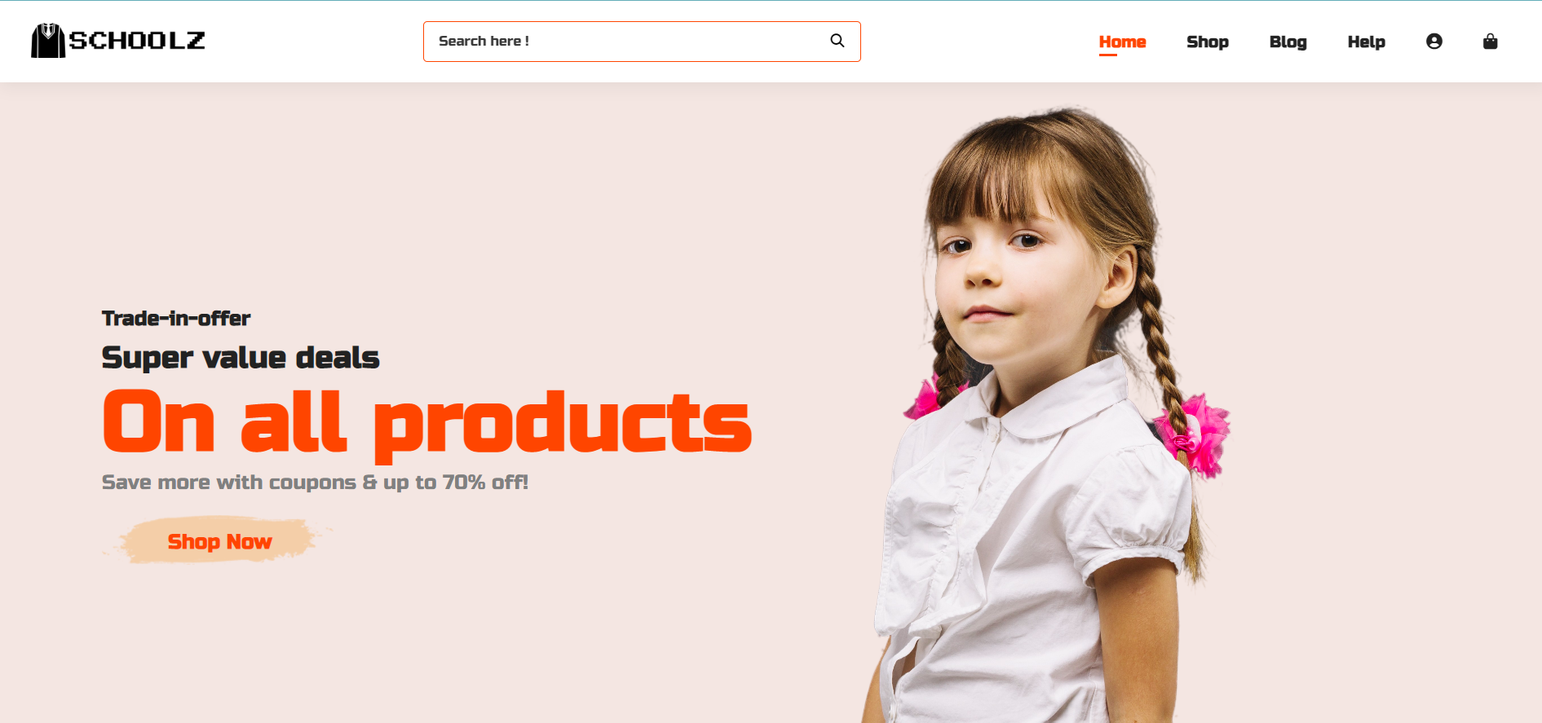
Abstract
The main aim of this project is to easy life of students, parents and schools / colleges at the time
of reopening by using a simple E - commerce Website.
This Website allow users to purchase all student accessories (ex: uniforms, tie, belt, shoes, socks,
books, and etc..) of a particular school/ college through online.
It consists of different sections or categories for easy access and we can select size of product.
This website is completely responsive and dynamic

Slide 5
LITERATURE SURVEY:
School uniforms are available only in the schools
We should go to the respected school to buy uniform.
There will be a lot of miscommunication regarding the selection of the sizes.
The survey points towards the
The Cost of uniforms.
The Time and Budget Problems.

Slide 6

What is E-Commerce ?
Commonly known as Electronic Marketing
“ It consist of buying and selling goods and services over an electronic systems such as the internet and other computer networks. “

Slide 7
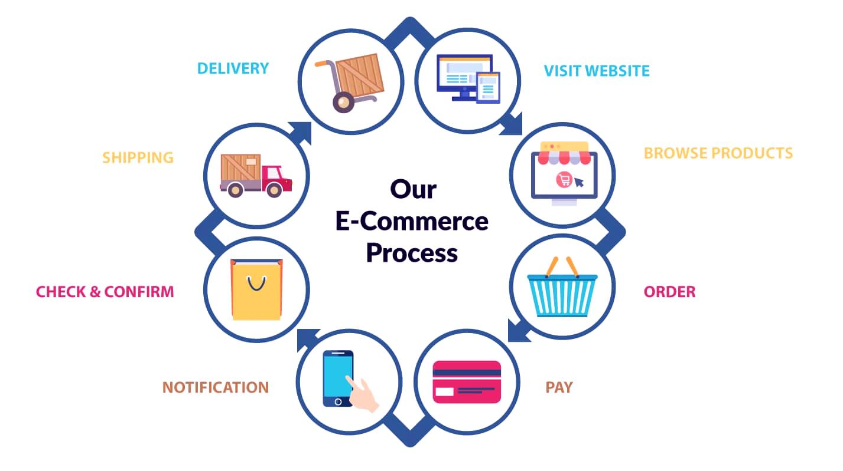
The Process of E-commerce

Slide 8
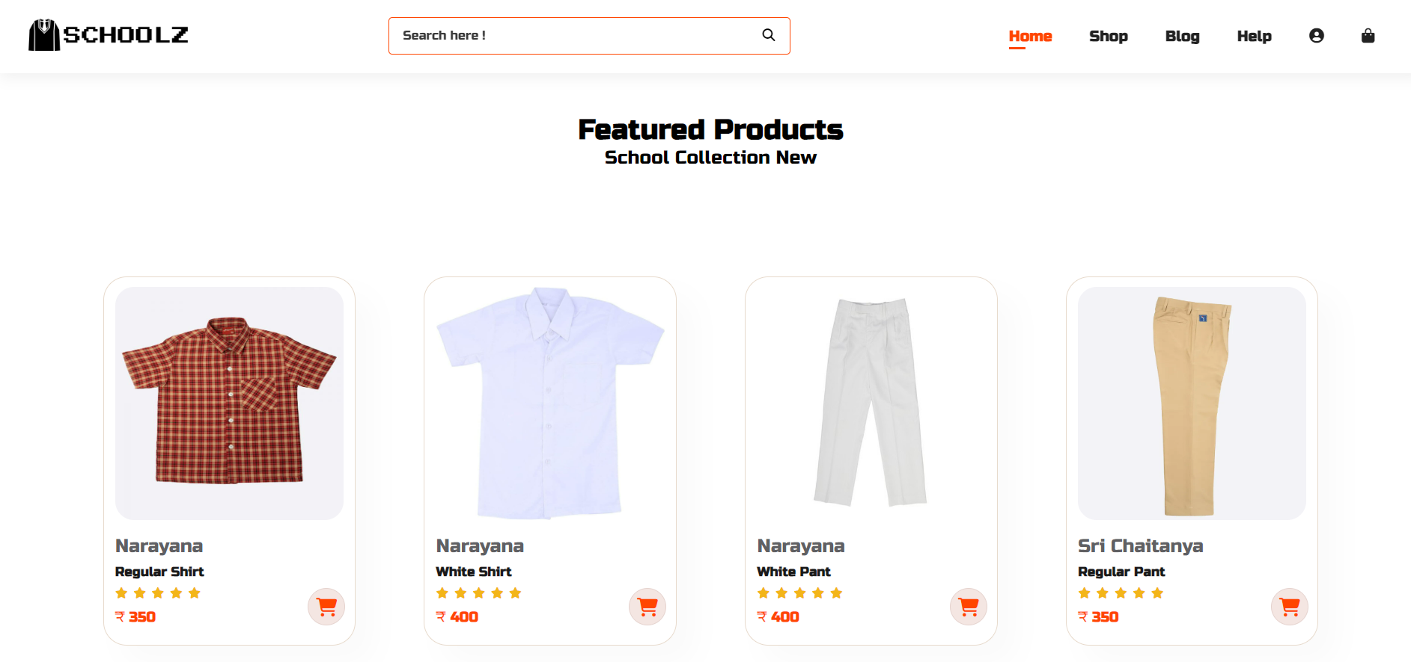
PROPOSED SYSTEM
Our system is an E - commerce website from where students can by their uniforms
At present we are dealing with school uniforms but later we will include college or universities

Slide 9
Features:
Home page
Shop page
Shopping Cart page
Account page

Slide 10
Languages
Tools
HTML 5
CSS 3
BOOTSTRAP
MYSQL
Adobe Photoshop
Visual Studio Code

Slide 11
Advantages
Faster buying/ selling procedure, as well as easy to find products.
Buying/ selling 24/ 7
Low costs and better quality of products.
Door step delivery

Slide 12
Disadvantages
Unable to examine products personally
Sometimes it may take more time to delivery

Slide 13
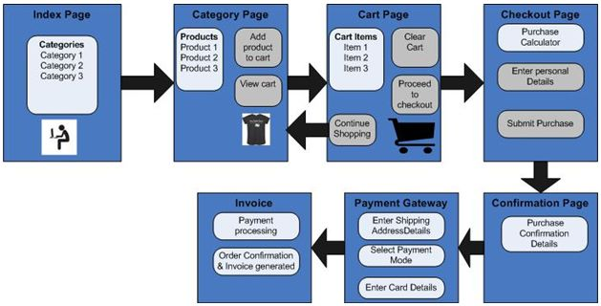
ARCHITECTURE

Slide 14
CONCLUSION
We are thinking of modifications and adding some advanced new features in out system. Some of them are –
# App
# Users can sell their products
# Users can signup / login using their social media handles like
Facebook, Google etc.

Slide 15
Screen Shots

Slide 16


Slide 17
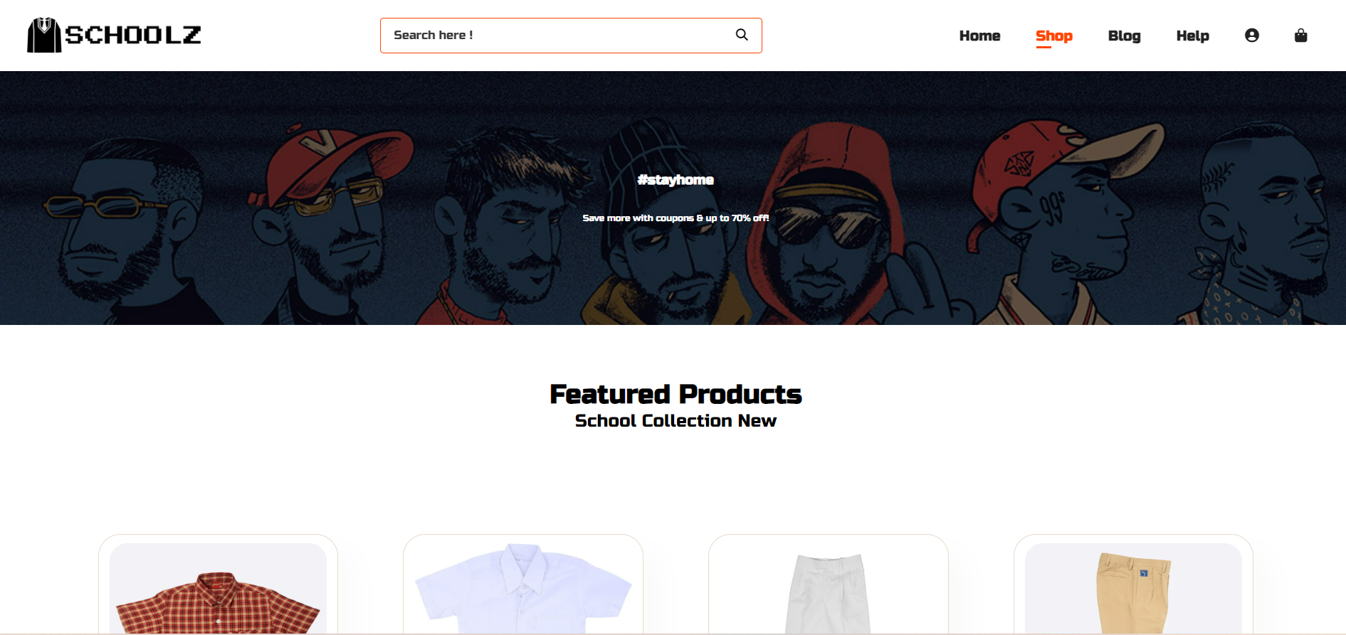

Slide 18
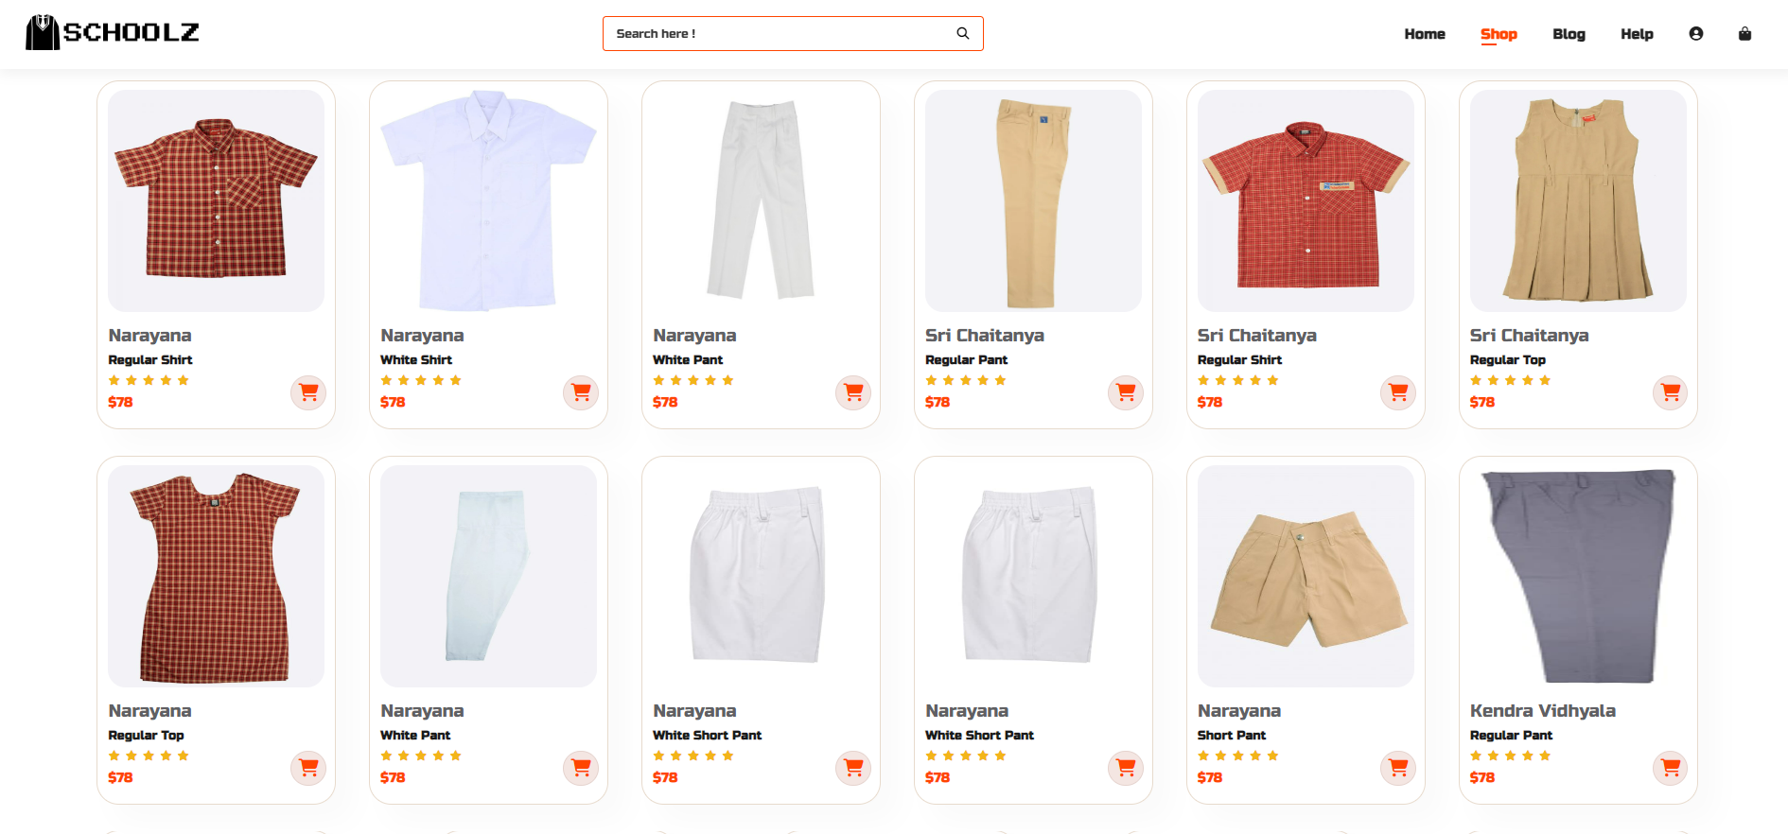

Slide 19
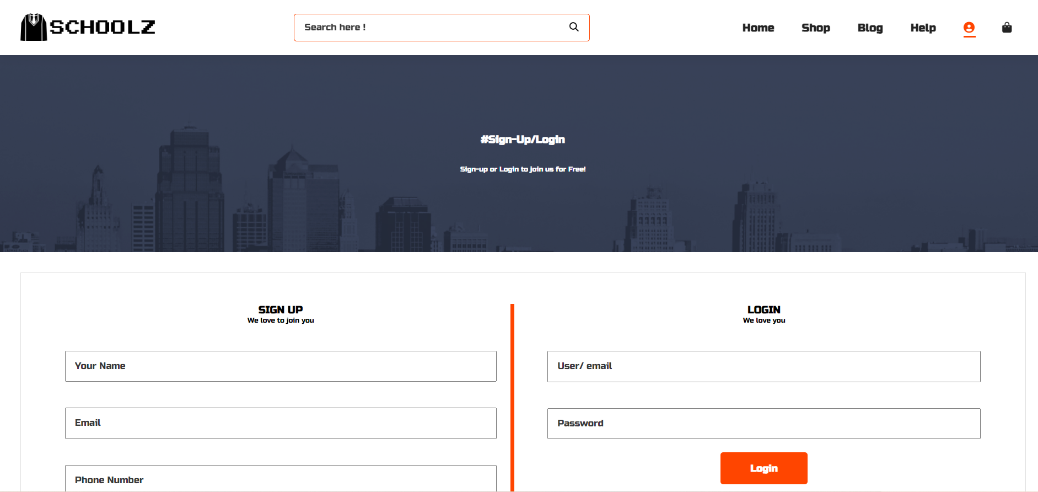

Slide 20
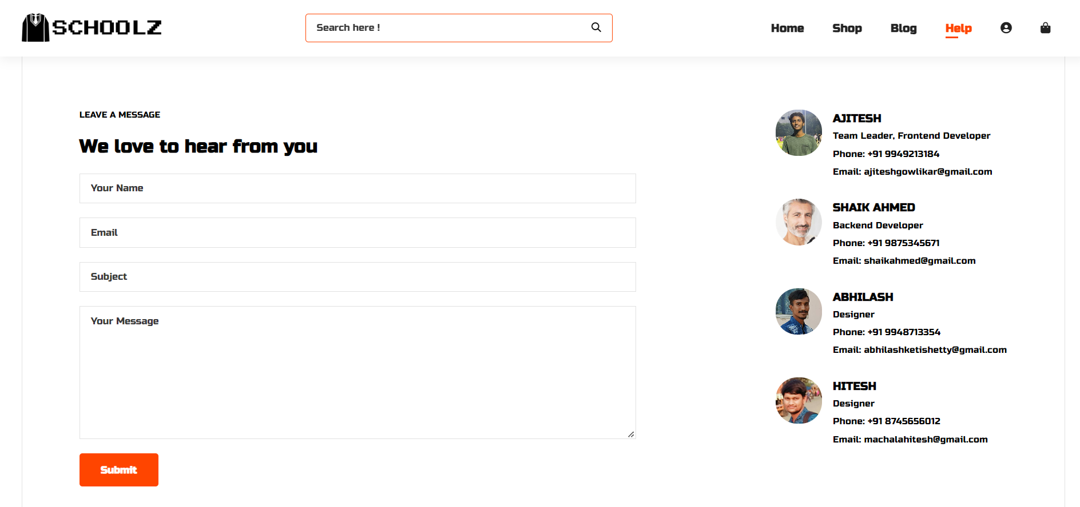

Slide 21
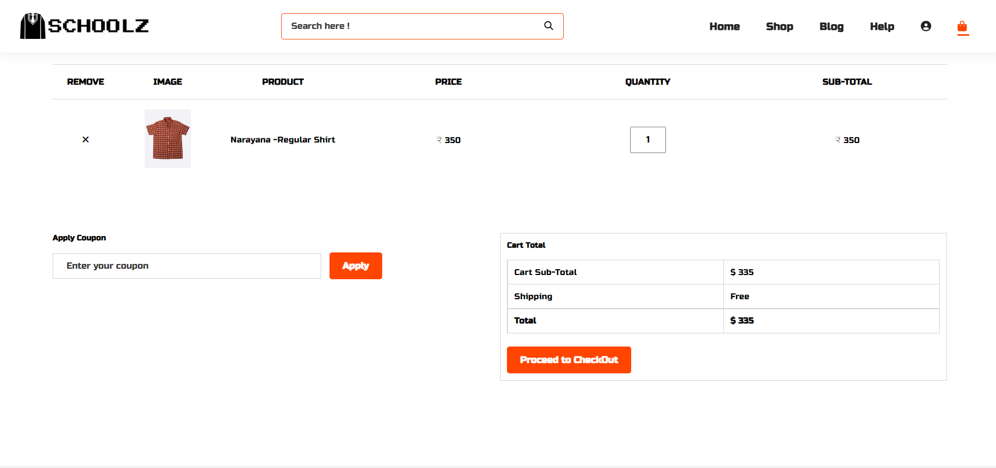

Slide 22


